Slide 1
Ingenious Mavericks
Academic Social Portal

Slide 2
Description
An academic portal which allows students to get information on the classes and the professors without being influenced by personal opinions.
A solution that prevents scenarios where students are confused about classes or face issues like class timing clashes or not having classes to take up.
A platform where students can discuss about swapping classes and answer questions asked about classes , professors or another academic and university related information.

Slide 3
Technologies
Angular 4
NodeJS
ExpressJS
MongoDB
AWS/Heroku
D3

Slide 4
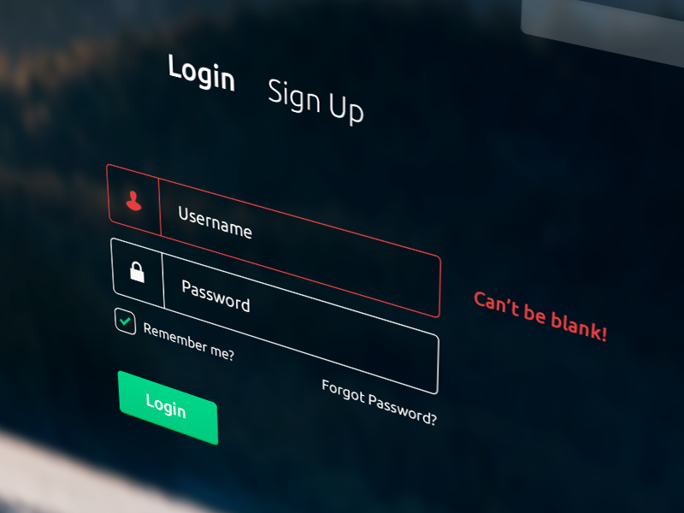
Webpage Entry Point
Login & Sign-Up Pages

Slide 5
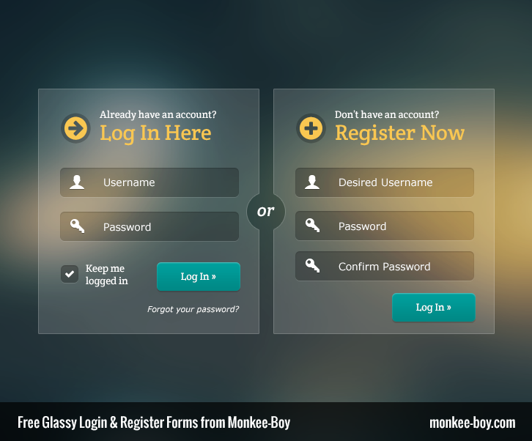
Security Points considered for Sign – Up
1.Only University email id allowed.
2. Common password constraints .
Information Collected for Sign- Up( Students)
1. Name
2.Department
3. Career
4.Year of Graduation

Slide 6
Subpages in the website
1. Rating Page/Reviews( professor-subject / professor)
2. Add Rate/Drop Rate of classes.
3. Swap Forum

Slide 7
1. Rating Page/Reviews( professor-subject / professor)
Fields Required:
Rating
Reviews
Class
Professor
Term

Slide 8
2. Add Rate/Drop Rate of classes.
Fields Required:
Class
Professor
Term
Add Rate
Drop Rate

Slide 9
3. Swap Forum
Portal where students can post and their requirements and find people to swap classes.

Slide 10
Demo of the website

